Slide 1
Voice Recognition

Slide 2
Application
Security
Ease to use

Slide 3

Basic Components
training
frames
Speech
Recognition
speech
feature
extraction
models
speech
capture
text
Speech
sample
Speaker
Identification
pattern
matching
results
processing
frames
speaker
results
Speaker
Verification
yes/no

Slide 4
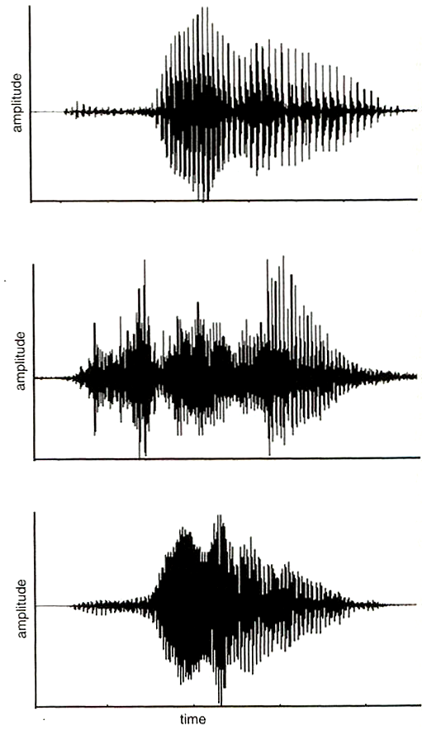
Time-domain waveforms for three talkers saying the word ‘zero’

Slide 5
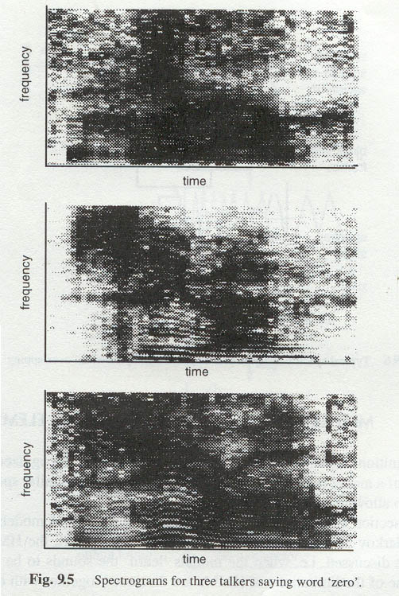
Spectrograms for three talkers saying word ‘ zero ’

Slide 6
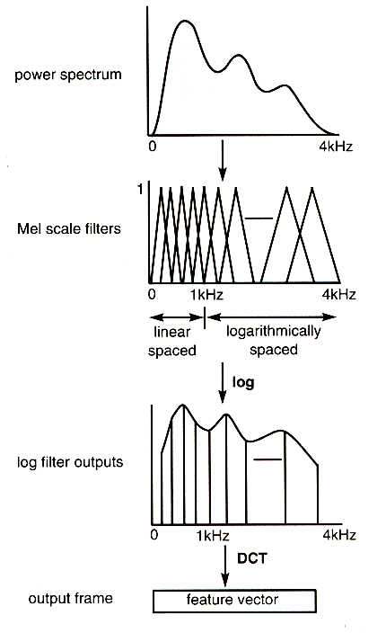
Transformation of the power spectrum

Slide 7
Basic Components
training
frames
Speech
Recognition
speech
feature
extraction
models
speech
capture
text
Speech
sample
Speaker
Identification
pattern
matching
results
processing
frames
speaker
results
Speaker
Verification
yes/no

Slide 8
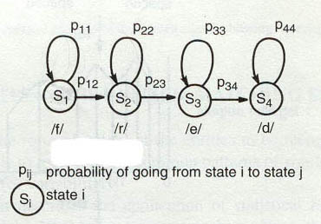
A hidden Markov models of the word ‘ fred ’

Slide 9
Basic Components
training
frames
Speech
Recognition
speech
feature
extraction
models
speech
capture
text
Speech
sample
Speaker
Identification
pattern
matching
results
processing
frames
speaker
results
Speaker
Verification
yes/no

Slide 10
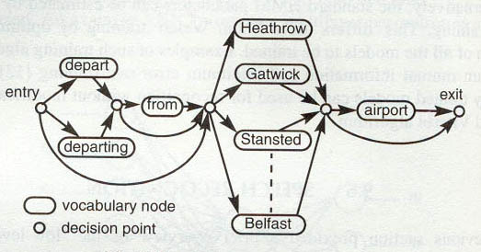
Simple grammar network

Slide 11
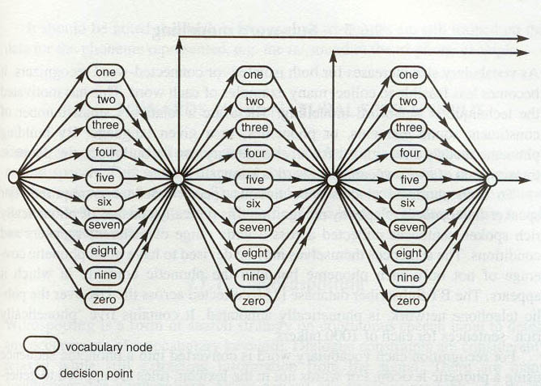
Grammar for string of up to three digits

Slide 12
โปรแกรม SpeakEZ Voice Print Speaker Verification
ออกแบบโดยบริษัท T-NETIX
Speaker Enrollment Process
Speaker Verification Process

Slide 13
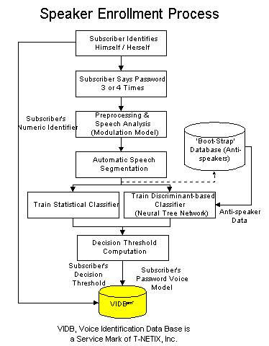
Speaker Enrollment Process

Slide 14
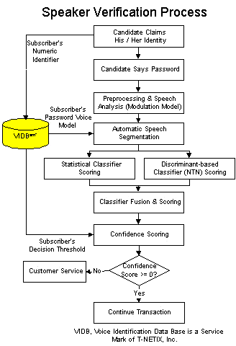
Speaker Verification Process

Slide 15
จบการนำเสนอ
นาย กิตติพงษ์ ประโยชน์บริบูรณ์ 40010052
นาย นฤชิต ดำรงวิถีธรรม 40010371

